Slide 1








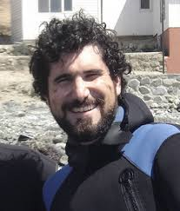

An alternative protocol to estimate sample size at different spatial scales in studies of ecological communities
Dr. Edlin Guerra-Castro
Dra. Maite Mascaró
Dr. Nuno Simoes
Dr. Juan J- Cruz-Motta

Slide 2
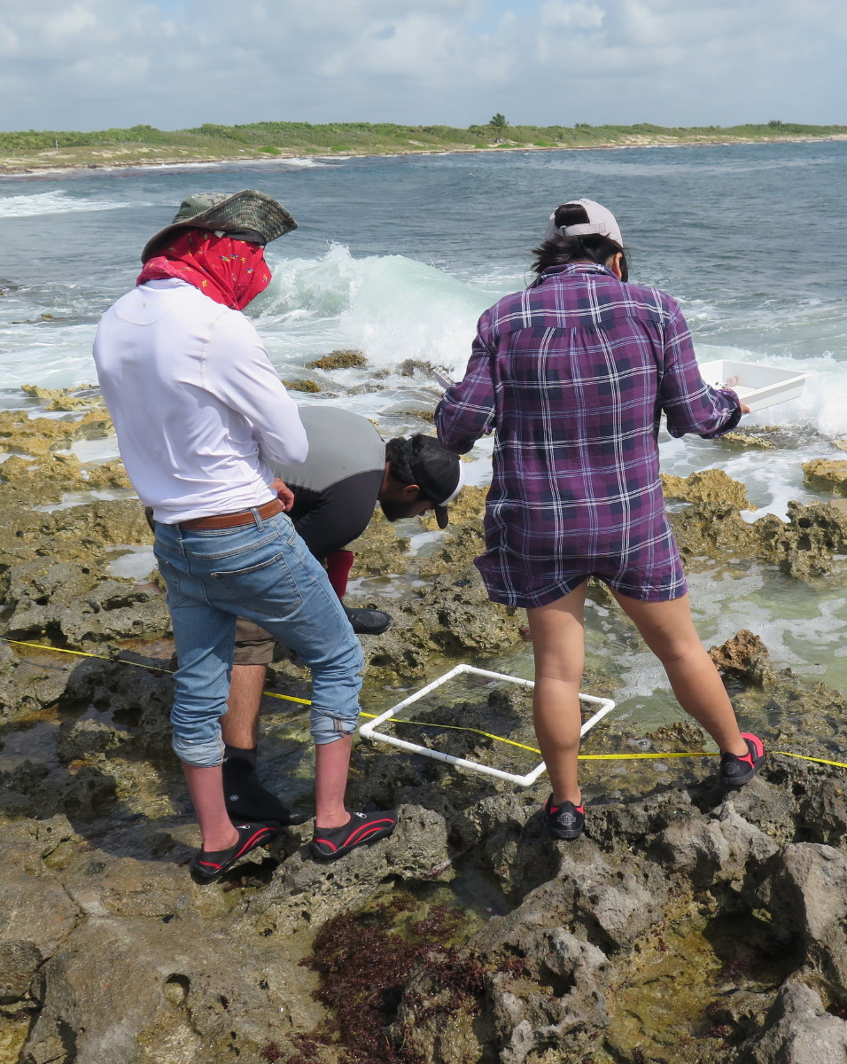
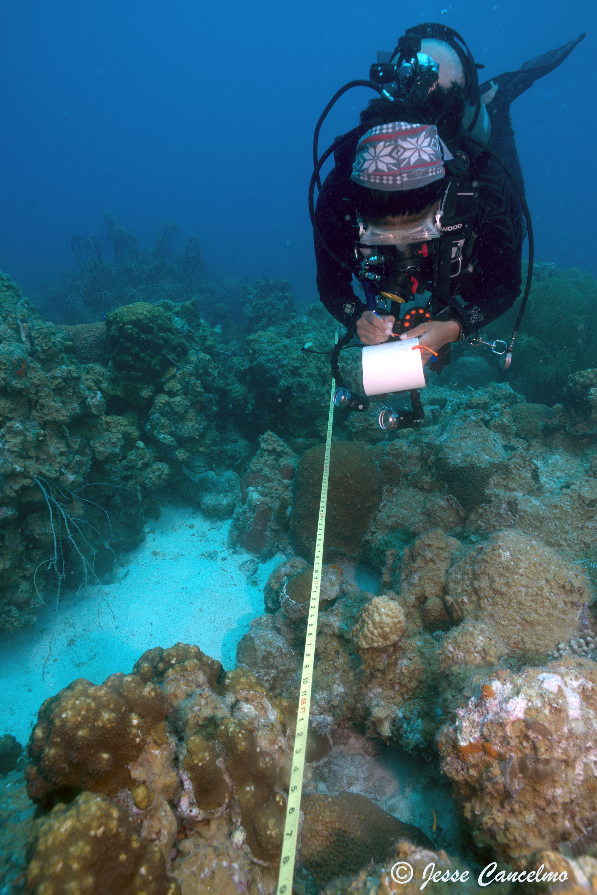
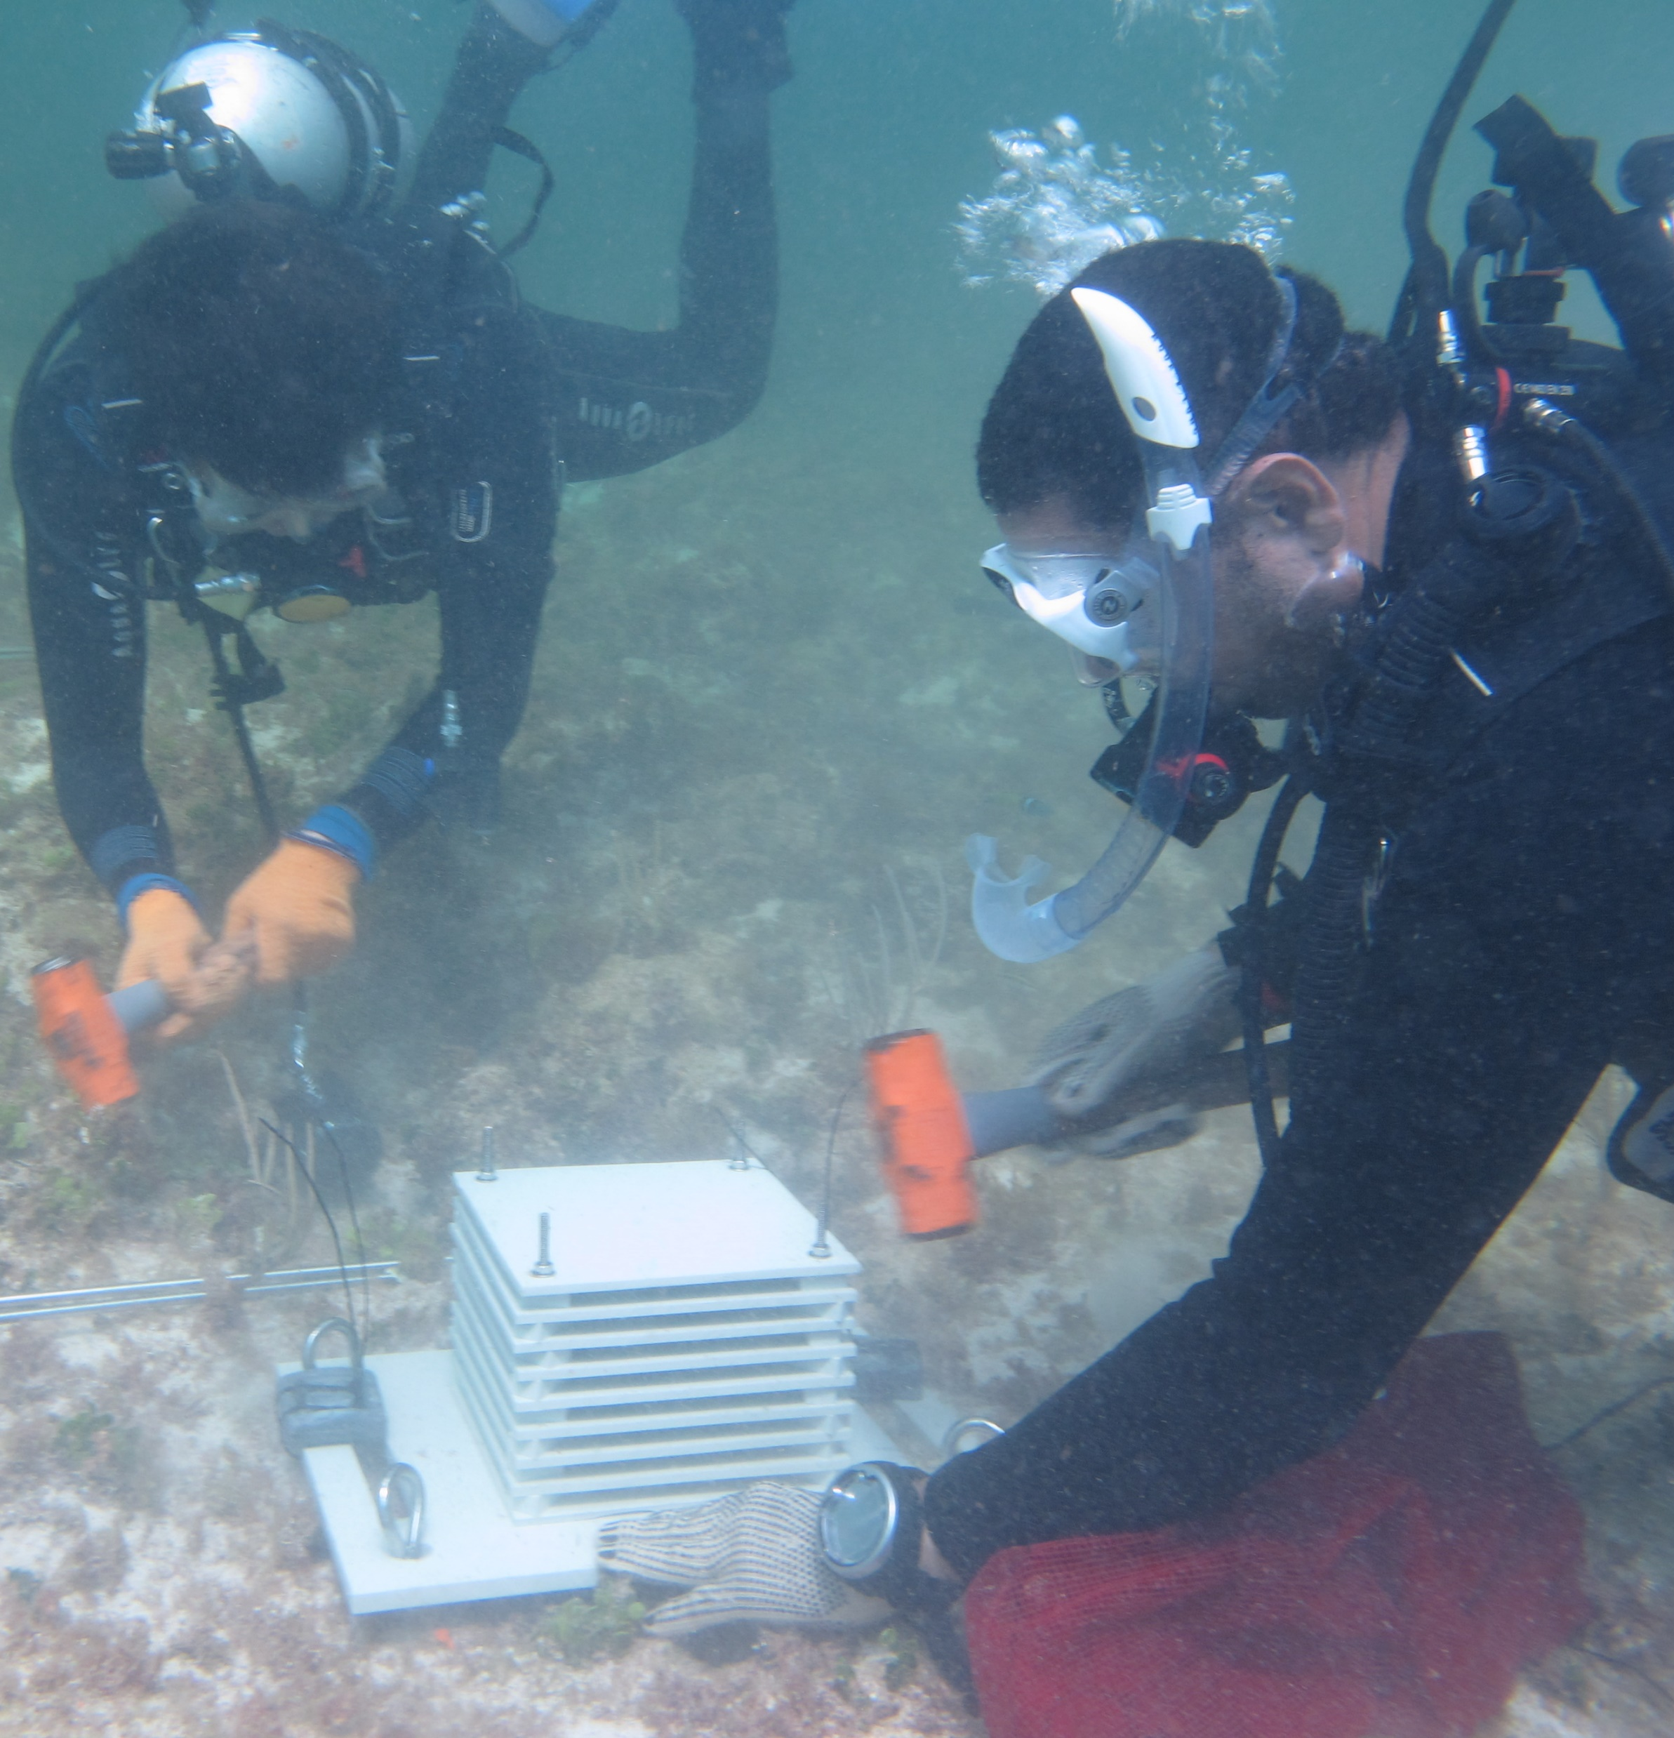

A typical question:
How many replicates we need to sufficiently characterize the community of interest?
-Few samples
Misleading and imprecise statistics & high rate of error Type II
-Several samples
Usually expensive, resources and time are limiting
Notes:
Fallar en detectar diferencias: Error tipo II

Slide 3
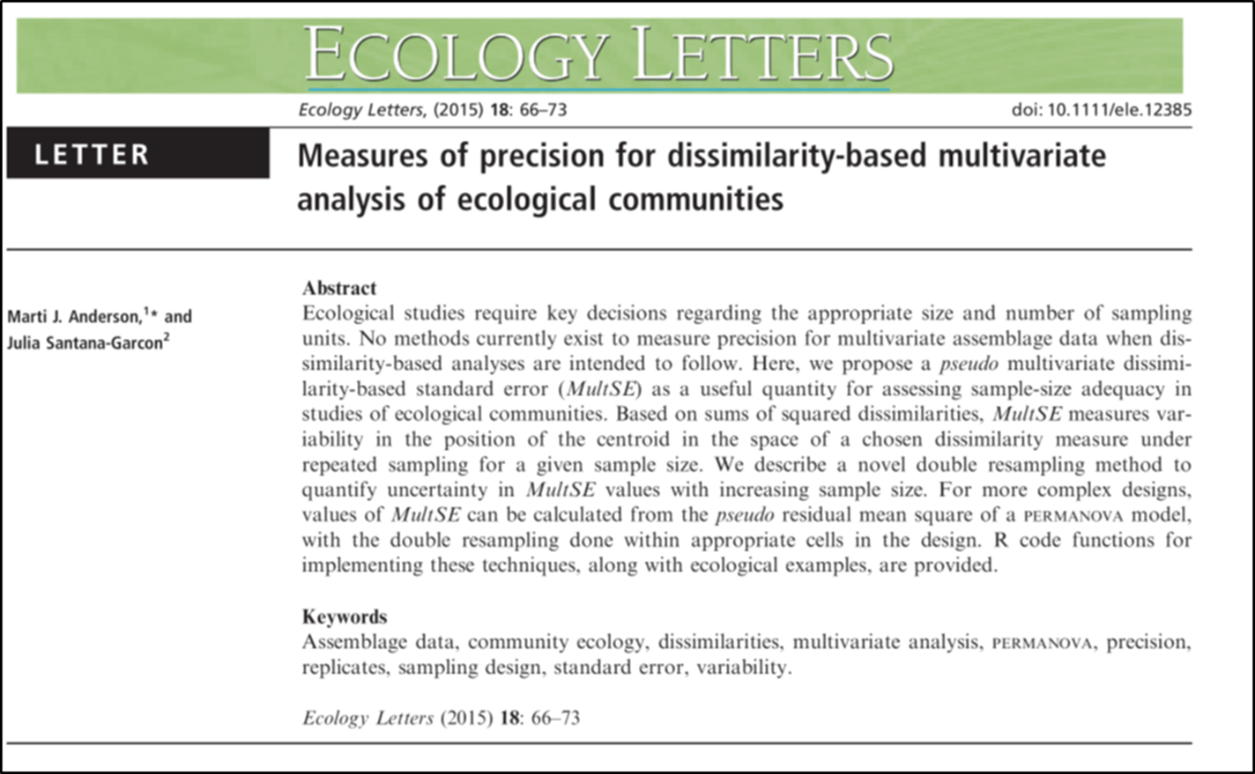
Estimation of sample size is an issue very well developed for univariate contexts.
However, nothing had been done in multivariate contexts, until:
Notes:
The study of communities has evolved from the use of univariate descriptors to the use of multivariate statistics

Slide 4

Multivariate Standard Error (MultSE)
Pseudo variance
MultSE
double resampling procedure on original data
MSEgroup.d
MSE.d
 | Sampling without replacement | Sampling with replacement
n | mean | lower | upper
2 | 0.22 | 0.21 | 0.23
3 | 0.19 | 0.18 | 0.20
4 | 0.17 | 0.16 | 0.18
… | …
12 | 0.11 | 0.10 | 0.13
Notes:
Anderson propuso un concepto: Error estandar Multivariado. Se estima a partir de la matriz de similitud a cualquier índice (Jaccard, Bary-Curtis, etc)
Esa varianza se trata de la misma forma que en contexto univariado para producer el error estandar multivariado
Un error estandar cerca a cero indica que el párámetro poblacional se estima con mucha precision. Un error estandar alto indica incertidumbre en la estimación del parámetro

Slide 5
The concept and method are extremely powerful, but have two limitations
this method cannot extrapolate the MultSE – n relationship beyond the sampling effort used during the pilot study
any random deviation of estimates obtained with the original sampling will be reiteratively reflected in the MultSEs
Notes:
Si el Proyecto Piloto tiene un n bajo, el procedimiento de Anderson no es util.
Random sampling will, on average, be accurate (as in a and b), but does not necessarily guarantee accuracy (as c).
LA GRÁFICA LA PASÉ LUEGO DE AGRADECIMEINTO POR SI TE PREGUNTAN Y TIENES TIEMPO DE DEMOSTRAR EL PUNTO

Slide 6
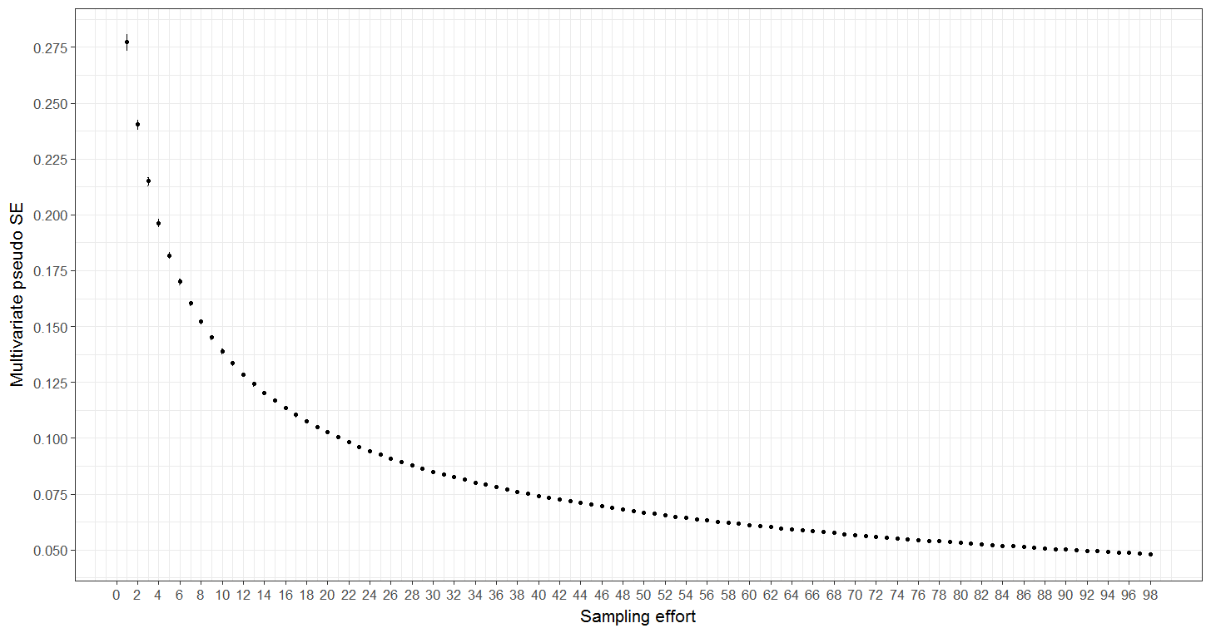
We are proposing an alternative protocol:
Instead of resampling pilot data, resampling simulated data
(a) Pilot data
Simulated data 1
Simulated data 2
Simulated data 100
Species observed
Species expected
Species expected
Species expected
Y_{p × n}
Sampling units
Simulated sampling units
Simulated sampling units
Simulated sampling units
n | mean | lower | upper
3 | 0.19 | 0.16 | 0.22
… | …
12 | 0.11 | 0.09 | 0.13
13 | 0.10 | 0.08 | 0.12
… | …
100 | 0.05 | 0.04 | 0.06
Average of MultSE for n = 3, 4 … N
Average of MultSE for n = 3, 4 … N
Average of MultSE for n = 3, 4 … N

Slide 7
What we need?
Preliminary knowledge about the community of interest (Pilot data):
  Some estimations of richness, evenness, abundance, probability of detection of each species, gregariousness, spatial autocorrelation.
  Then, what next?
Simulate several data matrixes using the above ecological properties as well as specific length of the matrixes (i.e. potential number of sampling units, potential number of sites)
Estimate MultSE for several repeated sampling efforts (samples and sites) for each simulated data, then estimate average for each effort.
Estimate the behavior of averaged MultSEs across simulated data using intervals and central tendencies.
Plot the relationship MultSE-effort.

Slide 8

We wrote five functions in R
AssemPar: Function that extracts the parameters of the community in the form of list, using several statistical analyses of data from a pilot project (using libraries as vegan and ape).
  SimDat: Function that simulate as many matrixes as requested, using estimated parameters in the list generated by AssemPar.
  QualitySD: Function that estimate: averaged number of species and evenness per sampling unit, and total multivariate dispersion of pilot data and simulated data matrixes
  SampSD: Function that repeatedly performs sampling (using the library sampling) with different effort for each of the simulated data matrices. For each one, MultSE is estimated using
    pseudo variance, for single site evaluation
    Mean squares in a PERMANOVA model (MS_{residual} and MS_{site}) for multisite evaluation
  MSEplot: It estimates the averages of the MultSE generated for each source of variation according to the repetitions of each sampling design. Means, lower and upper quantiles are tabulated for each sampling effort. The values are summarized in a data frame.

Slide 9
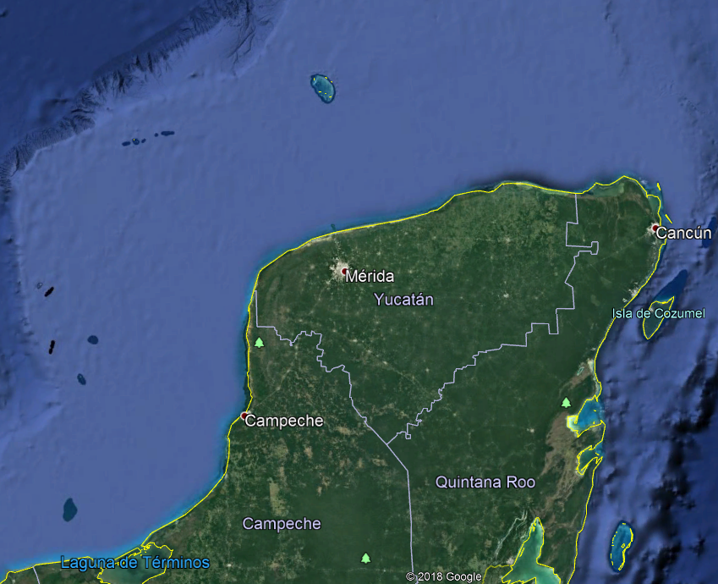
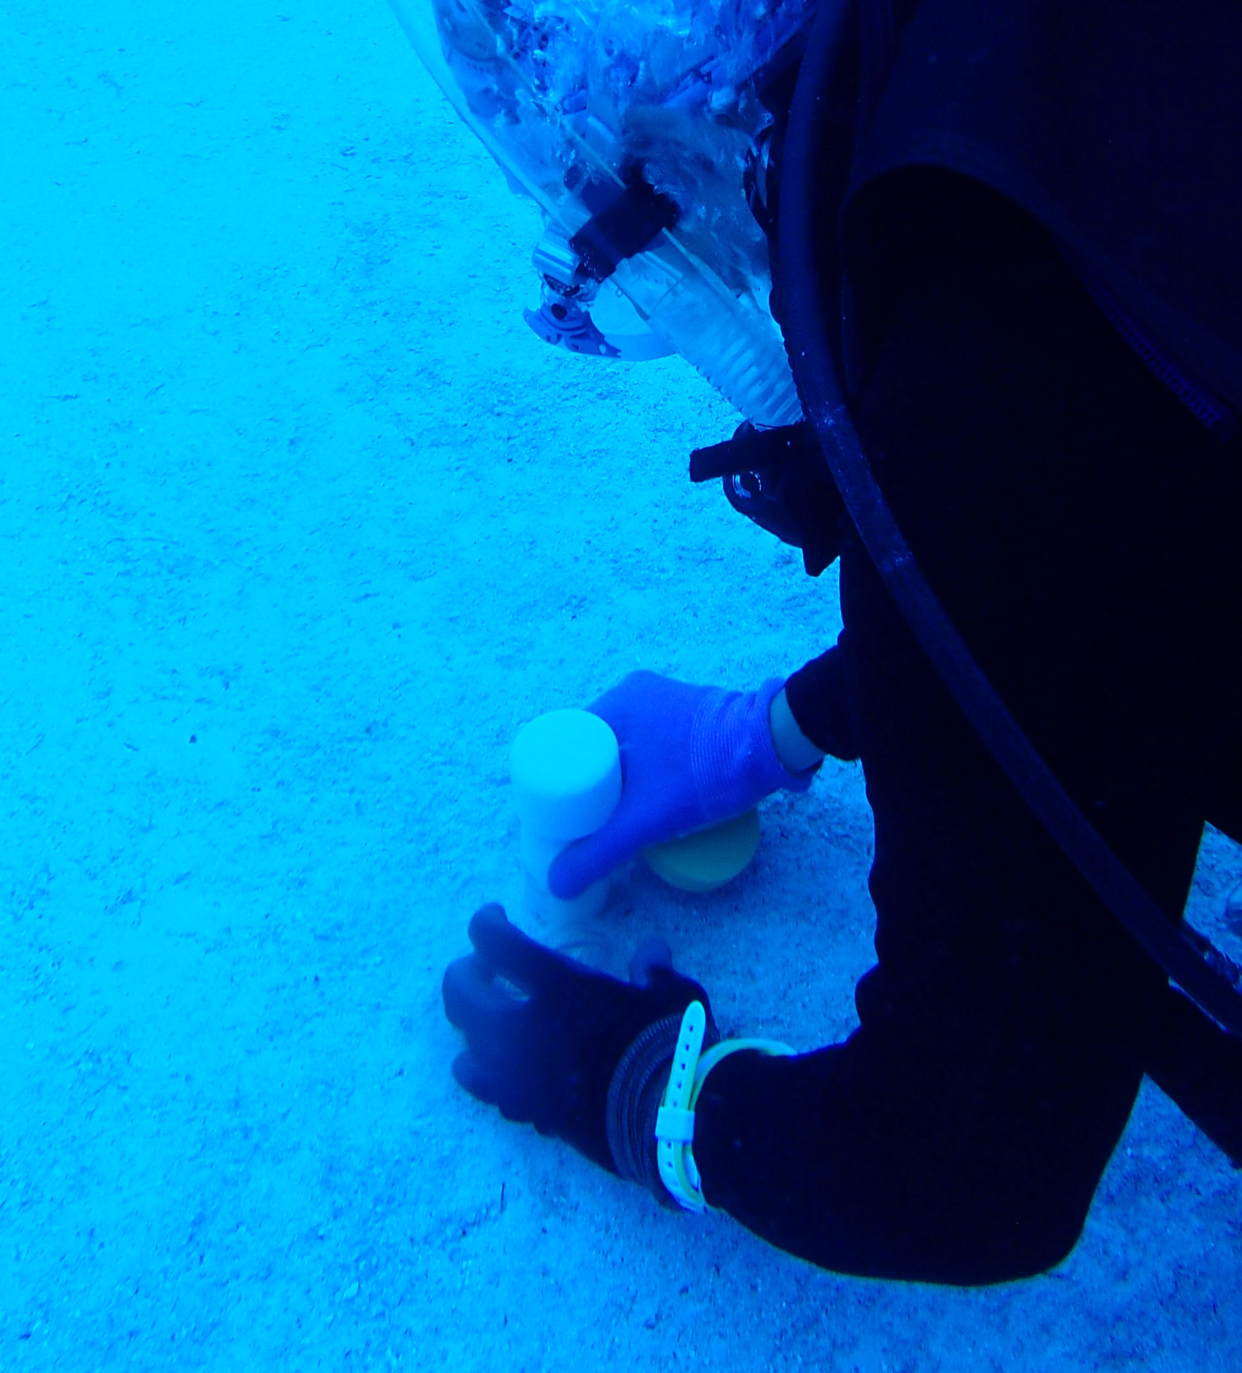
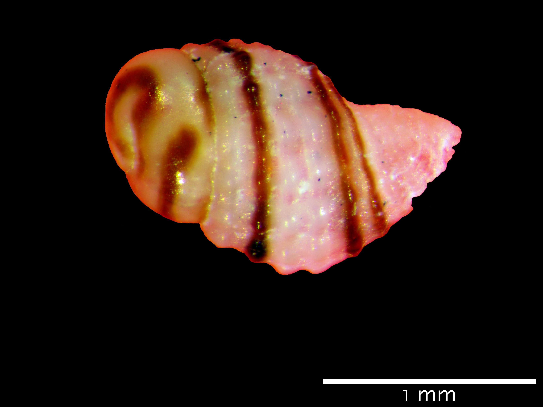
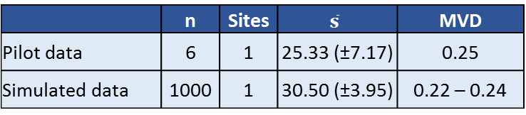
Evaluation of protocol with real data
Micromollusks of marine shallow sandy bottoms
Cayo Nuevo, Gulf of Mexico, México
Data: P/A of 68 species registered in six cores of 1.5-inch diameter and 10 cm
 | n | Sites | $$\overline{s}$$ | MVD
Pilot data | 6 | 1 | 25.33 (±7.17) | 0.25
Simulated data | 1000 | 1 | 30.50 (±3.95) | 0.22 – 0.24
↓25%
↓ 33%
↓ 50%

Slide 10
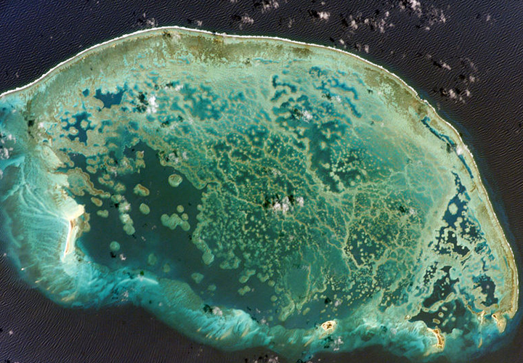
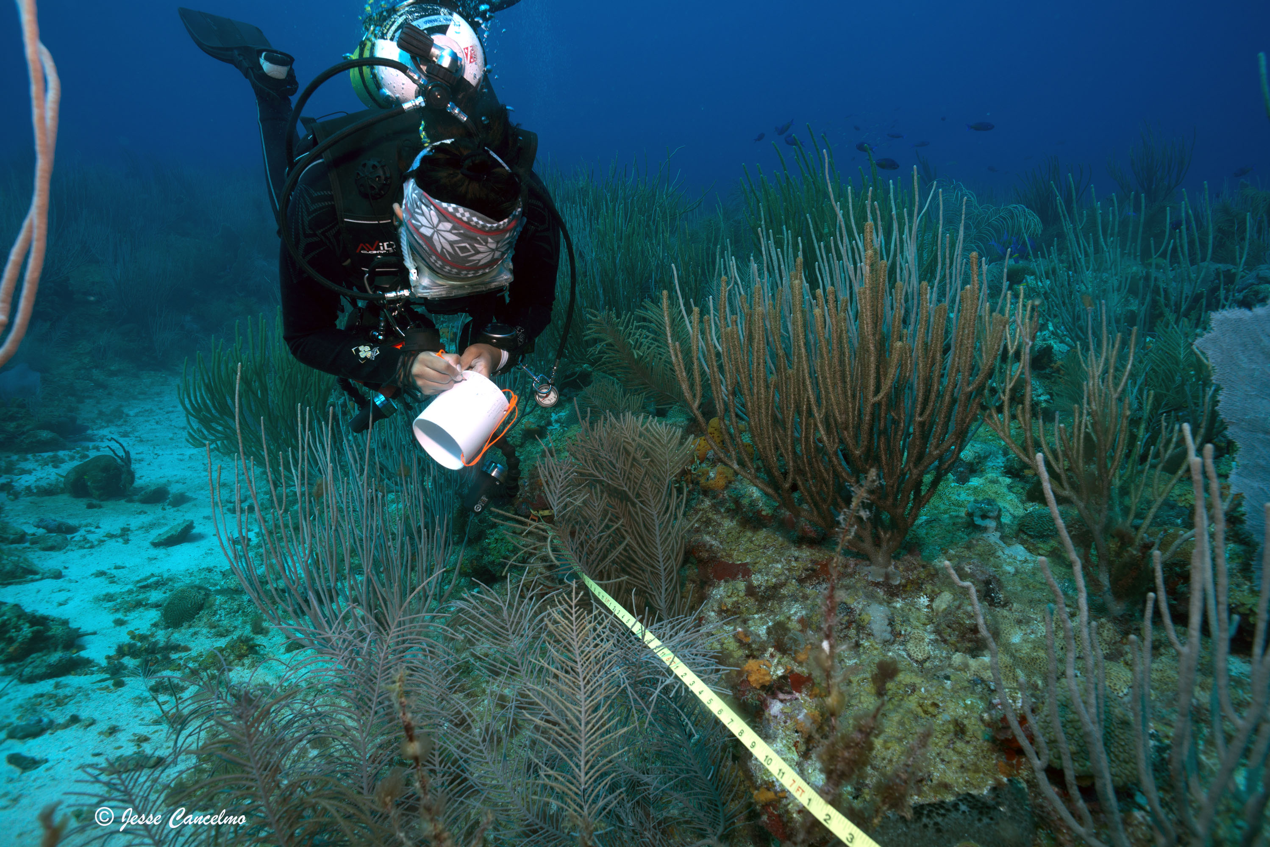
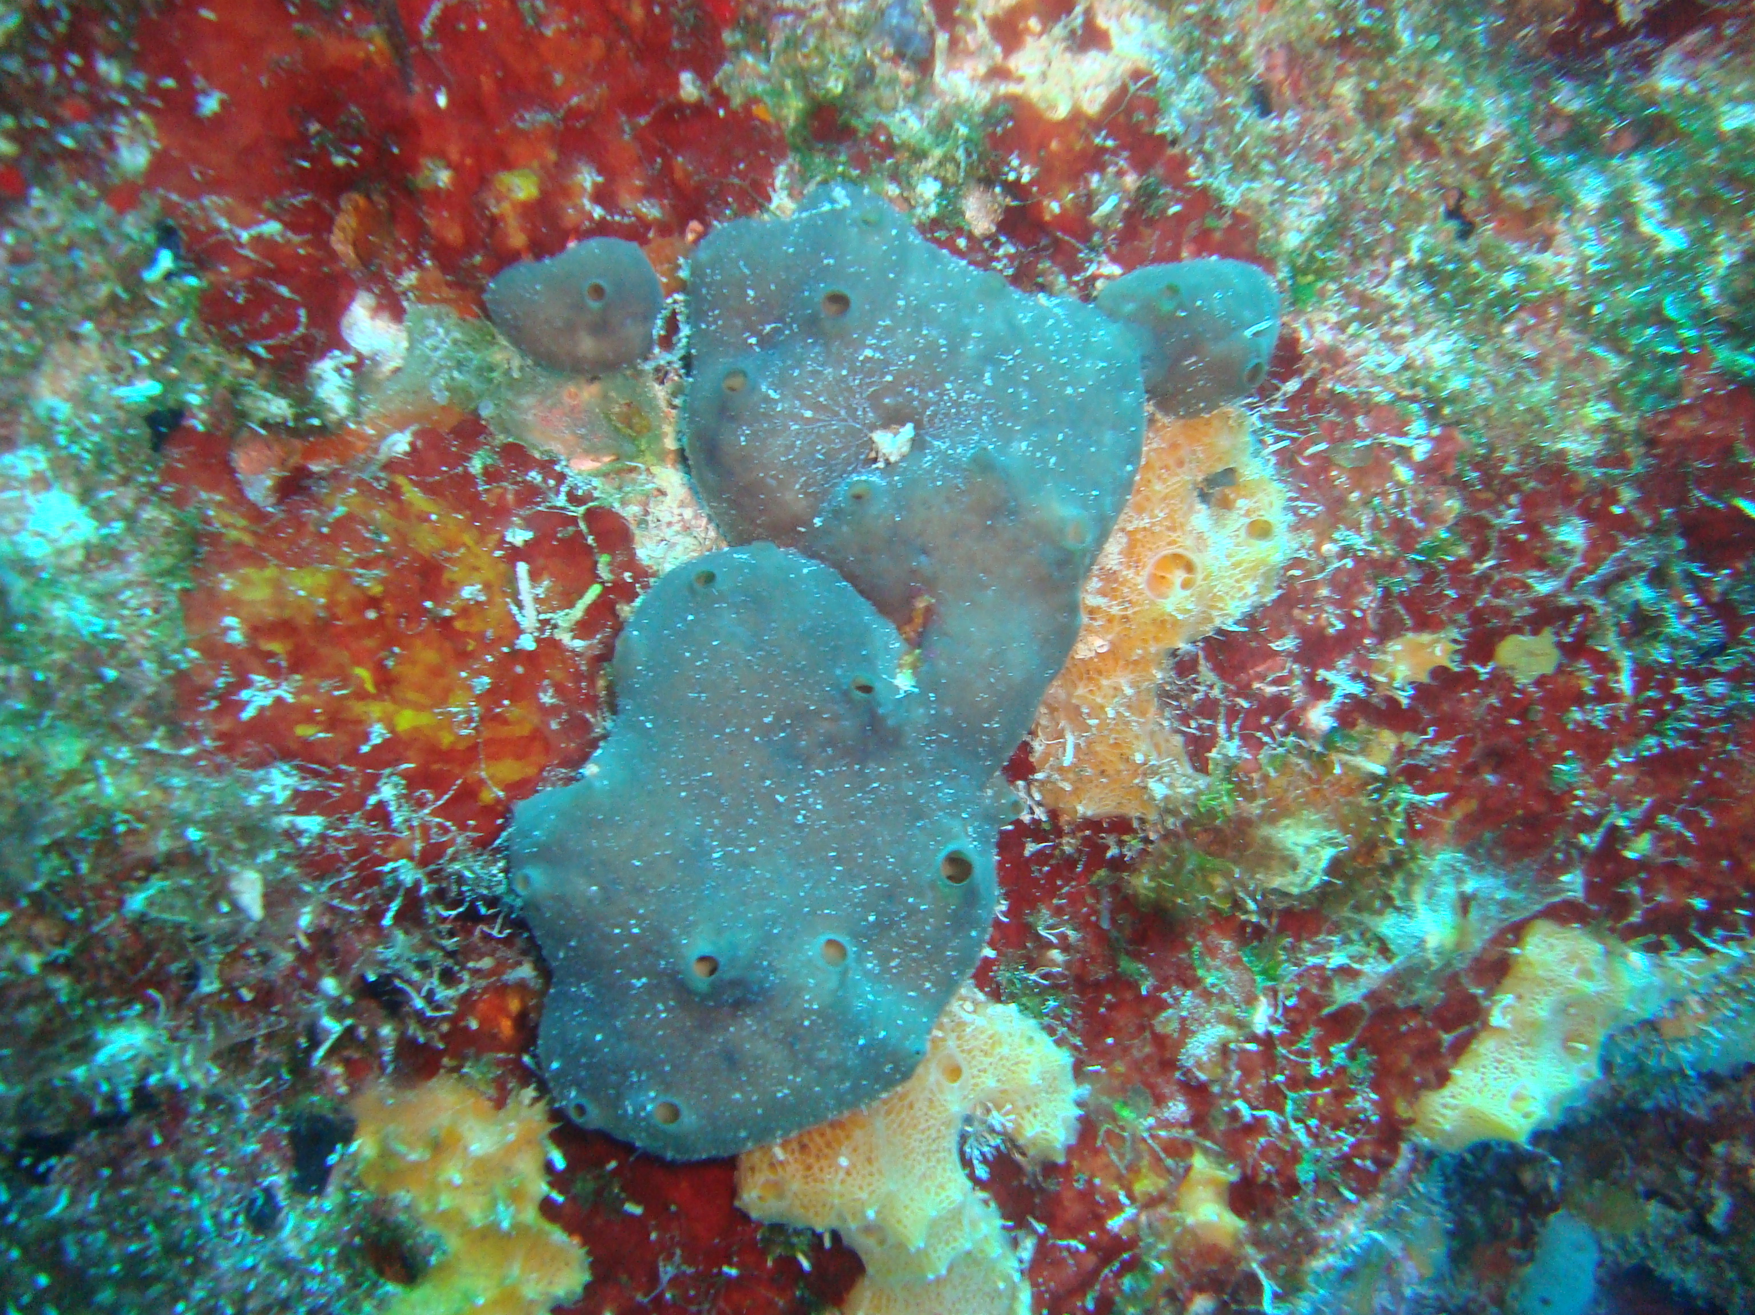
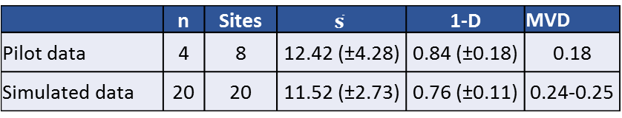
Evaluation of protocol with real data
Coral reef sponges
Alacranes Reef National Park, Gulf of Mexico, México
Data: # colonies for 41 sponge species registered in 4 transects of 20 m in 8 sites
 | n | Sites | $$\overline{s}$$ | 1-D | MVD
Pilot data | 4 | 8 | 12.42 (±4.28) | 0.84 (±0.18) | 0.18
Simulated data | 20 | 20 | 11.52 (±2.73) | 0.76 (±0.11) | 0.24-0.25
↓ 35%
↑10 %

Slide 11
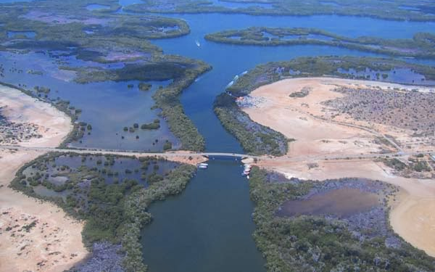

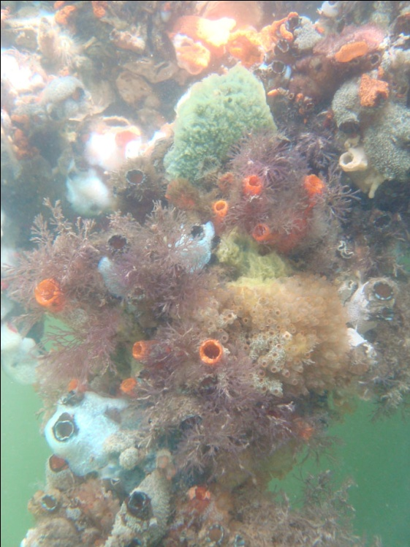
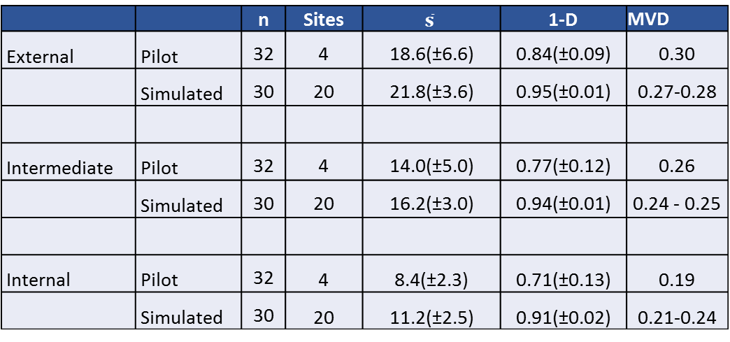
Evaluation of protocol with real data
Epibionts on Caribbean mangrove roots
La Restinga National Park, Venezuela
Data: cover of 110 species registered in 8 roots, 4 sites, 3 sectors along a gradient (96 samples)
 |  | n | Sites | $$\overline{s}$$ | 1-D | MVD
External | Pilot | 32 | 4 | 18.6(±6.6) | 0.84(±0.09) | 0.30
 | Simulated | 30 | 20 | 21.8(±3.6) | 0.95(±0.01) | 0.27-0.28
Intermediate | Pilot | 32 | 4 | 14.0(±5.0) | 0.77(±0.12) | 0.26
 | Simulated | 30 | 20 | 16.2(±3.0) | 0.94(±0.01) | 0.24 - 0.25
Internal | Pilot | 32 | 4 | 8.4(±2.3) | 0.71(±0.13) | 0.19
 | Simulated | 30 | 20 | 11.2(±2.5) | 0.91(±0.02) | 0.21-0.24

Slide 12
Finally, key points:
We expand the method developed by Anderson & Santana-Garcon (2015) but using simulations (instead of double resampling over original data), explicitly incorporating a higher spatial scales.
Our protocol is computationally intensive, time consuming, but usable by anyone.
The procedure is not free from assumptions: simulations do not consider any environmental constraint, neither specific cooccurrence structure of species.
Deductions of applying this protocol will lead to unbalanced and asymmetrical designs. This is no longer an analytical problem, all the groups are measured with the same precision (see Anderson et al. 2018 for the new version of PERMANOVA).
The R codes provided can be used as a powerful decision-making tool to define adequate sampling effort at various spatial scales.

Slide 13


Special Thanks
Edlin Guerra: DGAPA Post-doctoral Fellowship.
Maite Mascaro: Project PAPIME (No. PE207416)
Nuno Simoes: Furgason Fellowship International Chair for Coastal and Marine Studies in Mexico
Nuno Simoes: Project NEO18

Slide 14
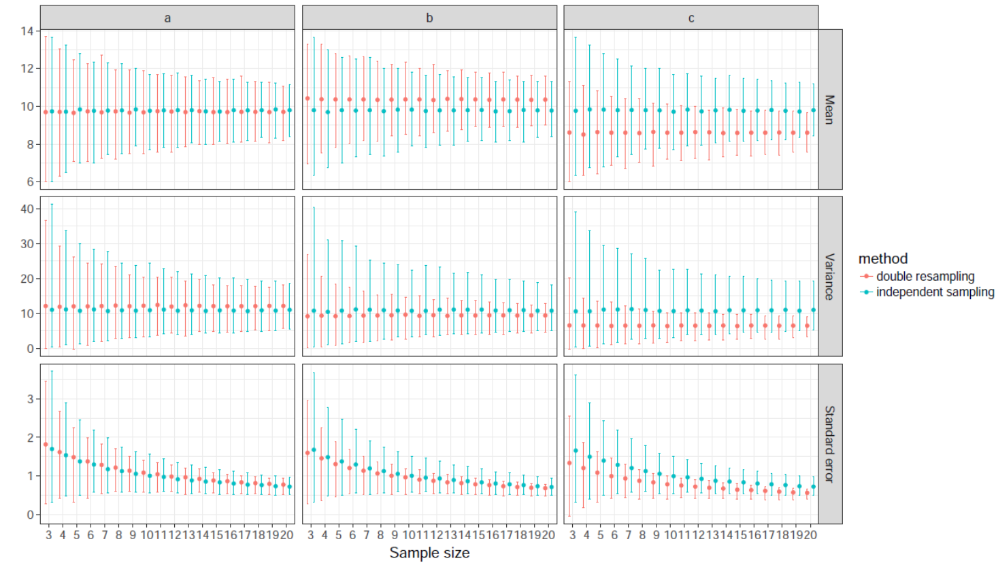
Notes:
Se simularon 1000 datos bajo una dstribución Poisson con promedio y varianza = 10. Se tomaron tres muestras aleatorias (a, b, c), cada una n=20 y se les aplicó el procedimiento de doble remuestreo desde sub.n = 2 hasta 20, 100 veces cada uno. Se estimó media, varianza y error estandar a cada n (símbolos rojos). También se tomaron muestras independientes sobre los 1000 datos desde n=2 a 20, 100 veces cada uno y se estimo media, varianza y error estandar (azules). Se demuestra como un muestreo aleatorio (el c) desviado del parámetro repercutió en el error estándar estimado con doble remuestreo. Se termina subestimando la varianza y recomendado un esfuerzo mas bajo que el real

